Slide 1

Palladium Movie Ticket Booking System

Slide 2


Prepared By :-
Name : POSHIYA ABHI TANSUKHBHAI
Roll no : 68
Enrollment No : 23002170110144
Batch : A2 Branch : CE

Slide 3




Introducing Palladium
Palladium Movie Ticket Booking System is an easy-to-use website where users can quickly check movie times, choose seats, and book tickets online.

Slide 4


Key Functionality
1
Search movies
2
Sign in/sign up
3
view trailers
Select your preferred
movie, date, and time
Choose seats and purchase tickets securely
Secure payment
4
5
6
7
Access your tickets
8
Contact us
9
About Us

Slide 5
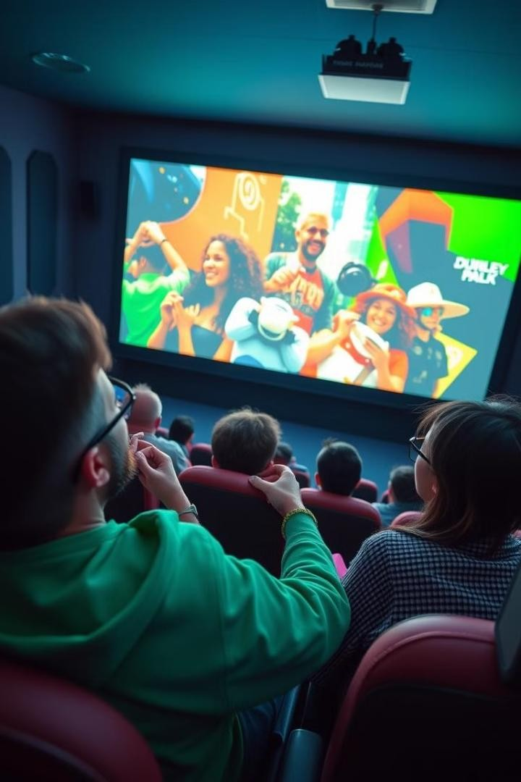
Merits
Convenience
Book tickets anytime, anywhere, from your device.
Efficiency
Skip the lines at the box office and save time.
Demerits
No real time updates

Slide 6
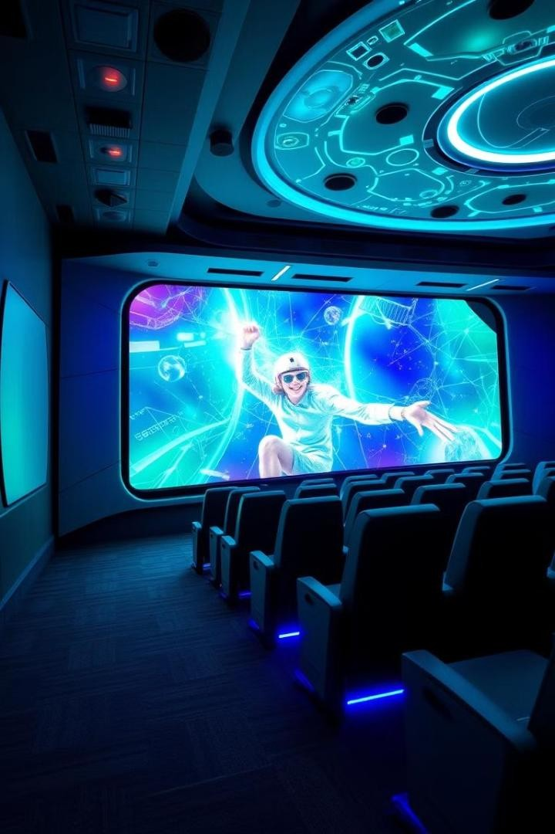
Future Scope of Palladium
In order to improve the real-time website, I will add a database and a backend language like Python. Jason will also be added to create an API server and handle data.

Slide 7





Development Tools
Frontend
HTML, CSS, Bootstrap
Backend
JavaScript

Slide 8



